Slide 1
ATV INSTRUCTION SEMINAR 2024
Presenter: Quan Nguyen Duc
Mail: quan.nguyenduc@amkor.com
Extension: 6254

Slide 2
Agenda
1
ATV IT ORG Introduce
2
ATV Data Center & Component
3
IT Concepts and Basic
4
IT System Landscape
5
eMES & SAP Overview
6
IT Activities and Improvements
7
Info Security
Notes:
Agenda/Outline Slide – Option 2

Slide 3


















Amkor-Technology ATV IT ORG
1.1, ATV IT ORG Introduce
JS Lim
IT
Sr. Director
Infra
Application
GH Kim
Network/Cabling
Sr. Director
JG Kim
Server/iSeries
Sr. Director
WH Choi
Security/Sv.Desk
Sr. Director
Thao PT
SAP/SRM
Staff
Dao NV
Bank/Test IC
Assistant Manager
Quan ND
Shipment/VIS
Assistant Manager
Richard LB
Schedule/RTS
Sr. Developer
Tam NV
Network/Cabling
Manager
Hue Pham Van
Deskside Support
Sr. Staff
Thao NV
Security/Sv.Desk
Assistant Manager
Thang ND
SAP/SRM
Staff
Long ND
Bank/Test IC
Staff
Dien ND
Shipment/VIS
Staff
Thanh TC
Schedule/Web
/AOA
Staff
Ngoc NT
Network
Manager
Loi Luu Van
Server/iSeries
Sr. Staff
Binh NV
Sv.Desk
Sr.Staff
Network
Server/Storage/VM
Services Desk/InfoSec
eMES & SAP

Slide 4
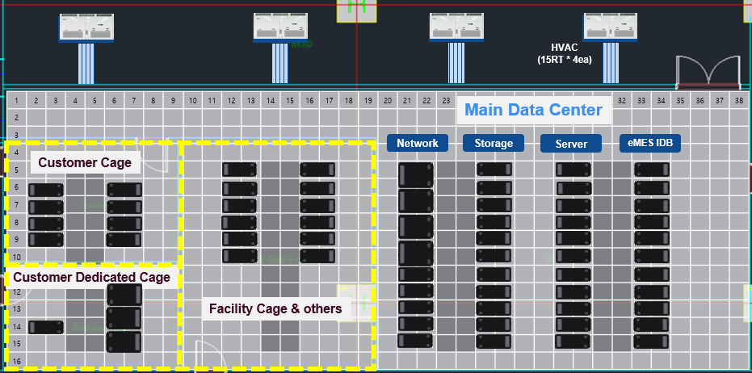
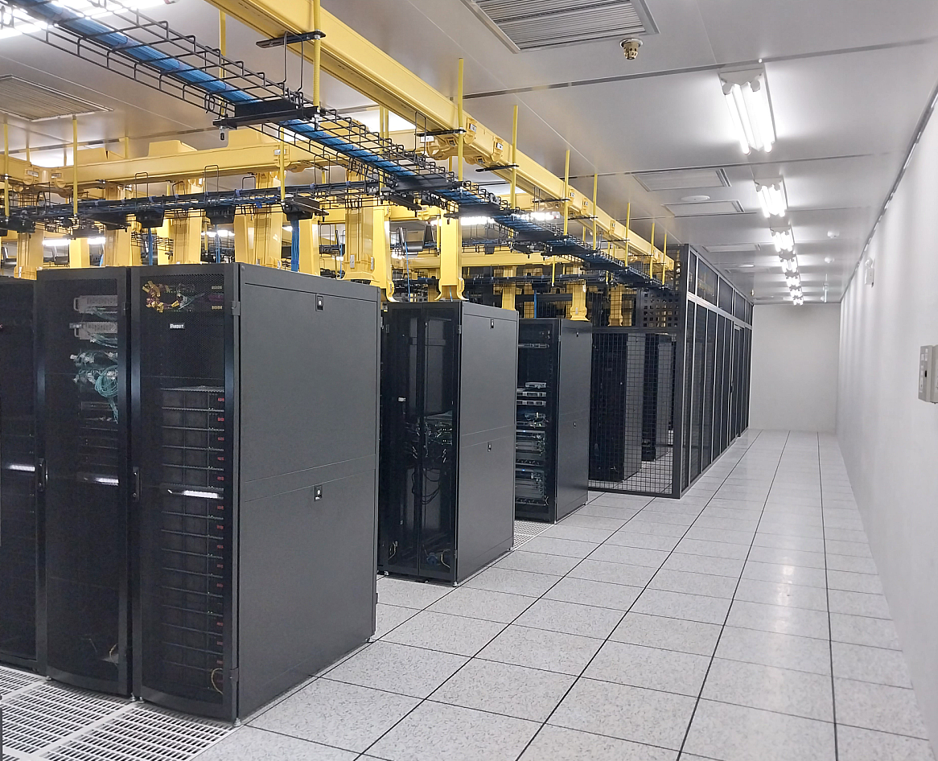
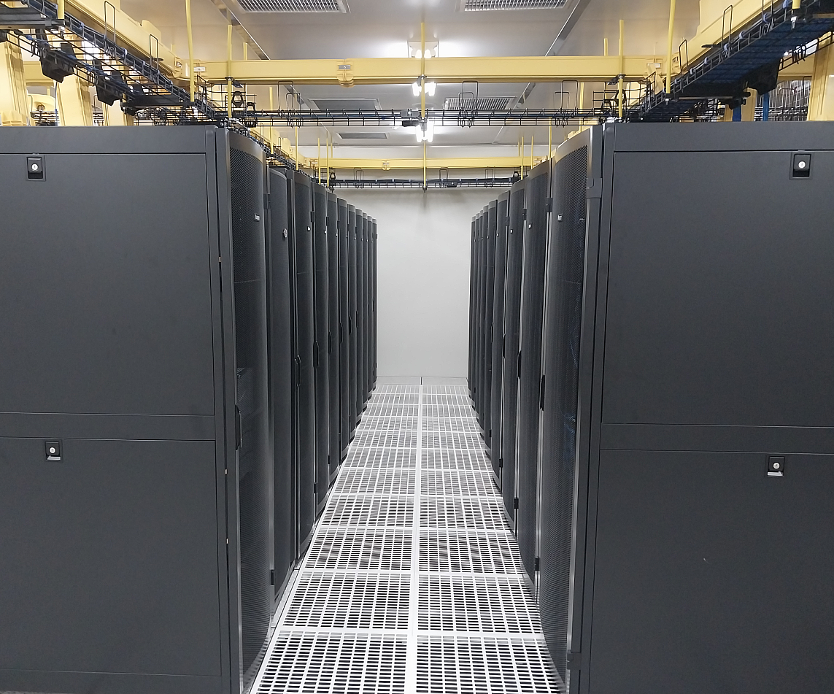
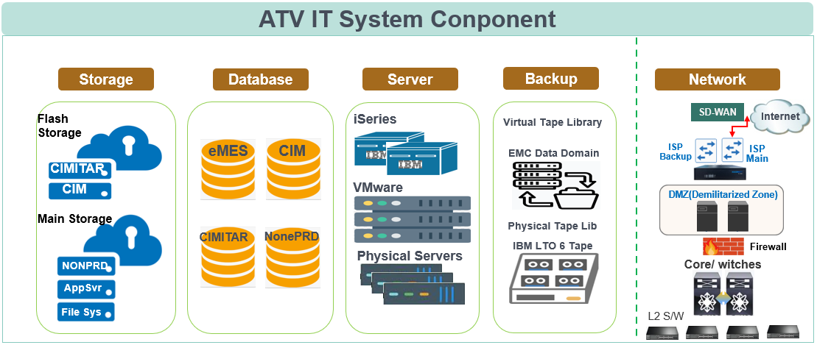
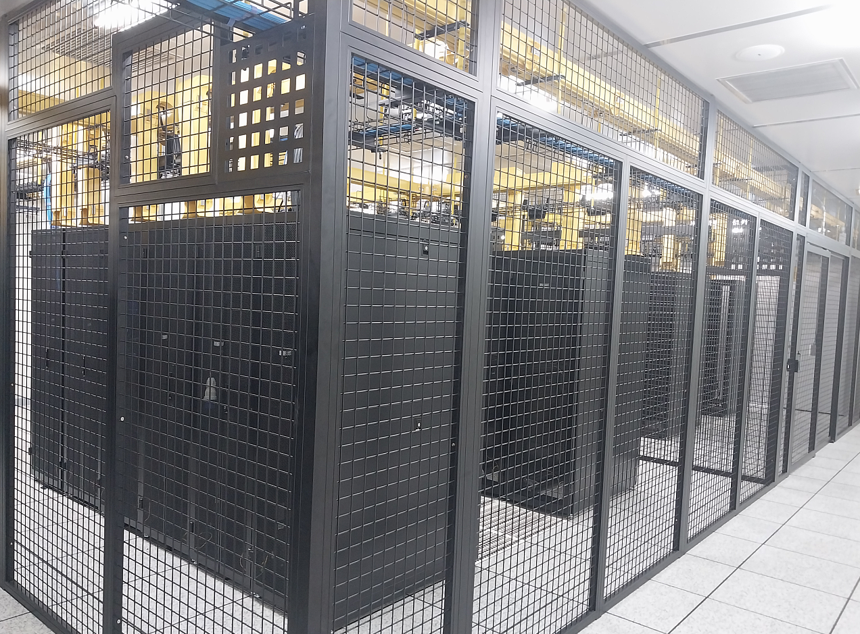
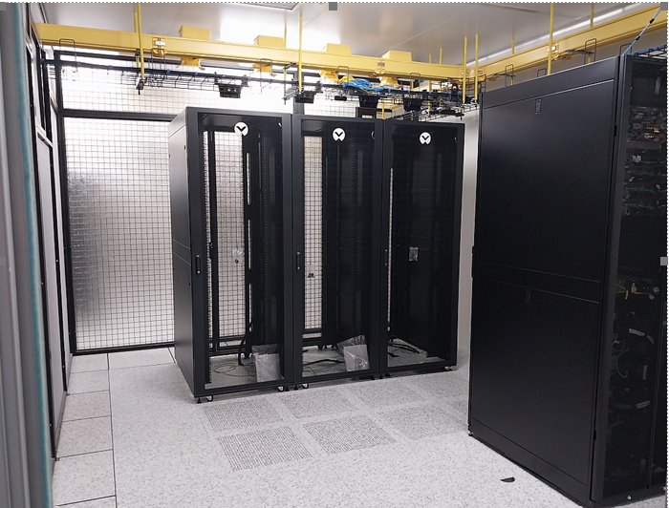
2, ATV IT Data Center & System Components
Pictures
Main Data Center
Rack Array
Customer Cage
Customer Dedicated Room
1Panda & 3JMet
Notes:
Currently already layout 30% (others will spare then use for 10 year later)
Storage Server for General purpose for storage files ….
SDWAN: software-defined WAN SD WAN là một kiến trúc mạng ảo cho phép doanh nghiệp

Slide 5



3, IT Concepts and Basic
What is IT ?
Information
Technology
Notes:
The diagram should show the relationship between IT, databases, and software. You can show how data flows from input devices such as a keyboard to the database and then to software applications.

Slide 6



3, IT Concepts and Basic
WAS/App
Database
(Storage data Computer)
What and how information using with computer
Report
Report
Move lot# A
Move lot# A
Move lot# A
Information
Technology
Move lot# A
Move lot# A
Move lot# A
Opr1
Opr2
Opr3
Notes:
The diagram should show the relationship between IT, databases, and software. You can show how data flows from input devices such as a keyboard to the database and then to software applications.

Slide 7



ATV Application System Landscape
4, IT System Landscape
Plan
ATKNet (ATVNet)
QMA
Quality
Management
Application
B2B
Approval
Request
GR Notification
SPIMS
(spare parts inventory management system
MRB
customer
Carry
In & Out
WI
SMS
(sms- scrap management system)
CART
(Corrective Action Request Tag)
Inline
MRB
APO
PLM
Receiving
IC Bank
NG
(No Good) Store
FG/BOM/Routing/
Confirm/GR/GI
Factory Automation
Die Bank
Logistics Mobile
MIN
(Marking Instruction Networking)
eCIM
RMS
(Recipe Management System)
FI
MM
COTest
Assy Schedule
Test
Schedule
OLS
(On Line Schedule Sheet)
Cimitar
SCOPS
APL
(Auto Program Loading)
CO
PP
New HR
PDC
(PCS product Document Center)
DCC
(QA Document Control Center)
QM
SD
Smart Console
Mobile
Smart Console
WIP Console
Standrol Log
ADE
(Automatic
Data Entry
Shipping
eDIS
(enhanced Dropship Integration System
PM
EXIM
Raspberry Pi
TMS (Tool Management System)
CMP
(Component Material Preparation)
DTS (Die Traceability System(ULT))
RPA
(Robotic Process Automation)
Label
RTS
(Resource Tracking System)
SWR
ROS (Remote Operation system)
RPS (Remote Production Support)
Billing
MFG
Portal
ALP
(Amkor Line Planning)
New
SPC
SRM
WMS
eBidding
VIS
(Visual Information System)
EDA
(Engineering Data Analysis)
Customer Specific Report
Notes:
As you can see in this Diagram we classify system/software in 5 parts:
1, SAP
2, eMES
3, Web support application/ QMA
4, Factory Automation
5, Report System
6

Slide 8
ATV eMES Application Flow
4, IT System Landscape
eMES
ISAN
Intransit Data, B2B Data
Intransit
Wafer GR / Wafer Matl Auto Creation
Die Bank
Die receipt
PDB
SWR
B2B
FG master
Pin Interface
Link SWR & lot
SO/PO Release
PO interface
Assy Schedule
Lot sch Info
MiN
Schedule
Die Confirm
SAP
Move into & Move Out
eRTS
Wafer Map Library
WMLS
ASSYOUT/PLTRANSFER//TESTOUT/PROBEOUT/WFBGOUT
COMPISS
GI to PO for SMD, Die Prep, Wafer or Assy IC
Allocate Machine
Assy WIP
Split/Combine , Hold/Release
PO Confirmation
SCRAP/QTYADJ(bank only)/COUNTVAR
Lot Information
StandRol Log
PO GR
eSPC
eCIM
GI to PO
Test FOL or Assy Stock
Test IC
Schedule
Lot Information
PO Confirmation
Test Schedule
CIMitar
PO GR
Test WIP
Wait Ship
Lot sch Info
MiN
Ship Out (OSAN)
DO
IF Ship
Data
Shipping
EXIM
Booking
Data
D-Center
Billing
Notes:
1, Firstly to understand process we should know 3 type production: Assy, Test, Turnkey 2, explain about PO confirmation

Slide 9

SAP Process integrated with eMES
4, IT System Landscape
SD
SD
MM
MM
PP
FI
Quotation
Pricing
Billing
Finance
Planning
Procurement
Inventory Management
Sales Order
Delivery Order & PGI
Wafer Stock
Goods Issue
Master Data
Production Order
WIP Confirmation
Goods Receipt
PIN Export
Die Bank Wafer GR
Lot Schedule
Wafer/Die Issue
WIP Transaction
Store In
Shipping
TestQ / T-Stock
D-Center

Slide 10
ATV eMES Scope
4, IT System Landscape
Centralized WIP
WIP Lot Movement
Production Line Monitoring
Equipment Allocation & Monitoring
Automatic BOM Consumption
Paperless Manufacturing
thru AL-tag, OLTC & eTR
Online Instruction
Product Tracking & Genealogy
Complete History of all WIP lots
Production Management
WIP Console
Normal Scheduling & Pre-Scheduling
Online Schedule Sheet
Customer Specific Attribute Control
Multi Die Control & Traceability
Online Special Instruction Control
Online Bonding Diagram
Work Order Management
Schedule, eSWR, eBD
Equipment Management
RTS
Equipment Maintenance
Equipment Qualification
Equipment Tracking
Equipment History
PM Scheduling
PM Overview
Quality Management
WIP Console Gate, SPC
SPC Monitoring
OCAP Control
SPC Chart
Inspection thru QA Gate
Statistic Analysis for Quality
Inventory Management
DieBank, Test IC, NG Store
Shipping, eDIS
Status Control of Wafer/IC GR & GI
Shipping Control
Shipment Document
Drop Ship Lot Control

Slide 11
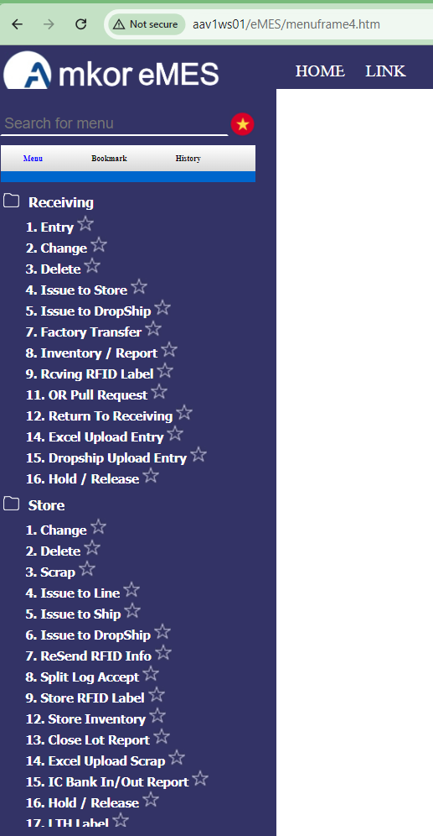
Receiving + Store
5, eMES overview
User – Logistics team
Rework , Test Only, Inter-Factory Assembled lot management
Main function
Receive FG at Rcv’g => WMS Label attach at Rcv’g => Transfer to Store => FG stock management at Store => (Schedule ) => Issue to WIP
Menu : eMES > Receiving, eMES > Store
Notes:
Show link eMES, expand the menu to show the detail to more explain

Slide 12
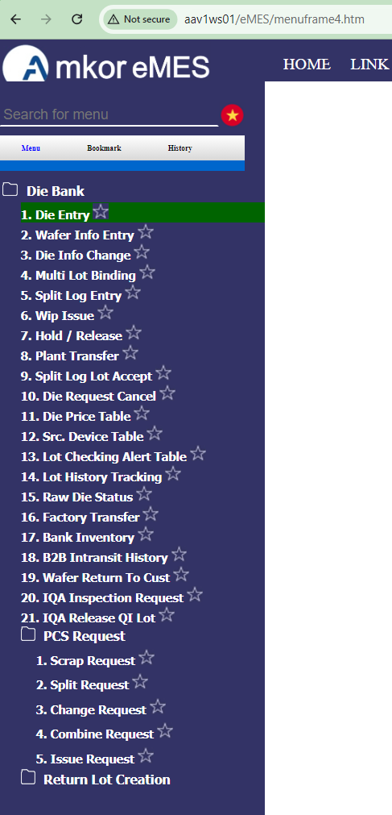
Die Bank
5, eMES overview
User – Logistics team.
Main function
Wafer entry
Wafer Slice ID input
Wafer issue to line
Split Log management
Menu : eMES > Die Bank
Notes:
Show link eMES, expand the menu to show the detail to more explain

Slide 13
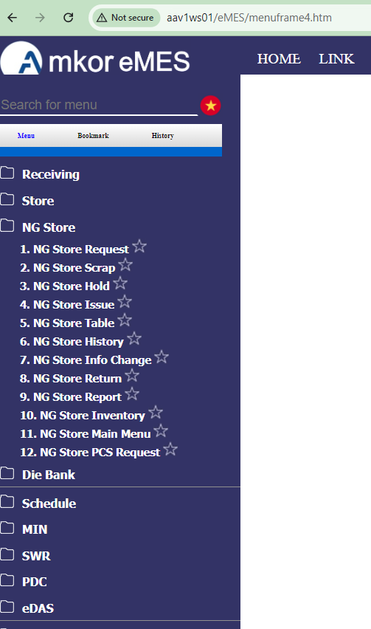
NG Store
5, eMES overview
User – Logistics team(NG Store)
Reject & Scrap lot entry/stock/issue management
Main function
Reject & Scrap lot entry
Reject & Scrap lot scrap
Reject & Scrap lot issue
Menu : eMES > NG Store
Notes:
Show link eMES, expand the menu to show the detail to more explain

Slide 14
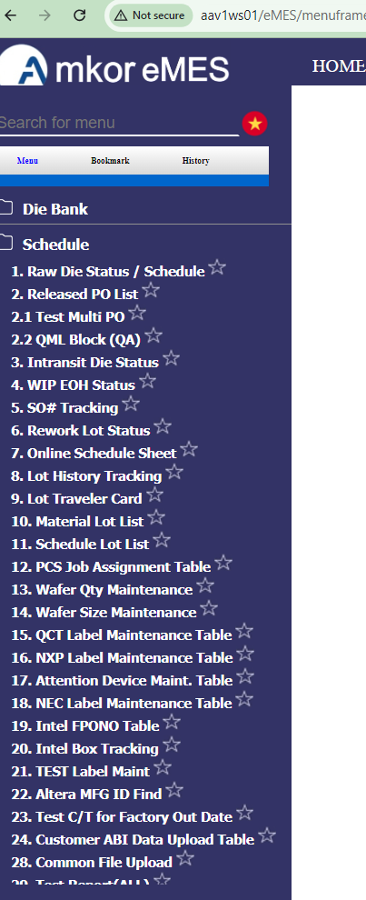
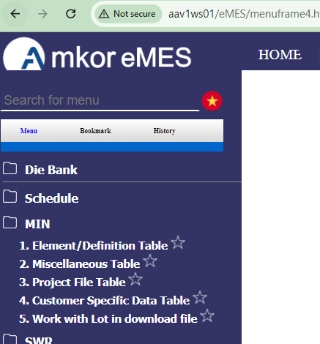
Schedule 1/3
5, eMES overview
User –PC/CS team
Main function
Schedule creation
SO(Sales Order) creation at SAP
=> PO(Production Order)creation at SAP
PO Interface from SAP to eMES
Select PO at eMES => Schedule at eMES
Schedule information change
On Line Schedule Sheet creation
MiN(Marking instruction Network) Data management
Notes:
Show link eMES, expand the menu to show the detail to more explain

Slide 15
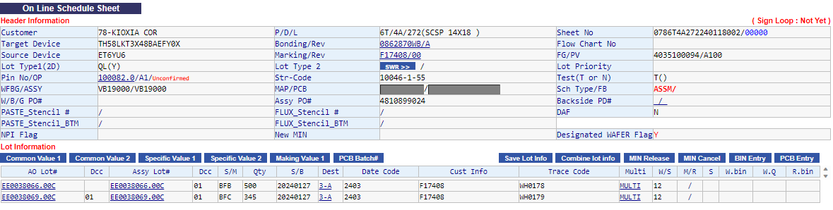
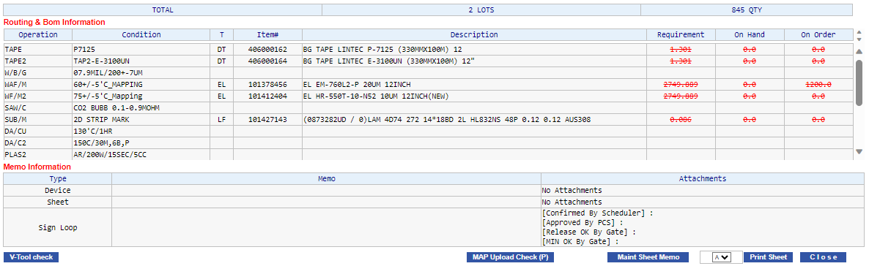
Schedule 2/3
5, eMES overview
Online Schedule Sheet (Menu : eMES > Schedule > 7. OLS)
- Basic Schedule Inform. Routing & Bom, Bonding & Marking
PCS Memo, Device Memo provide.
Notes:
Show link eMES, expand the menu to show the detail to more explain

Slide 16
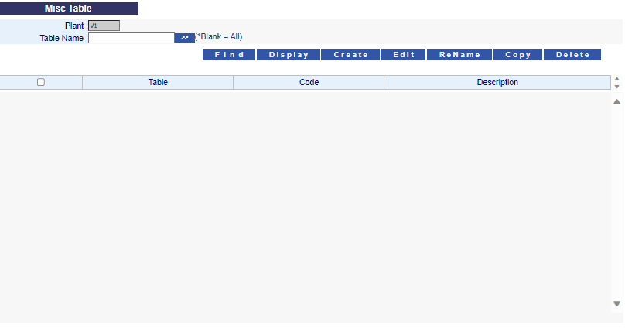
Schedule 3/3
5, eMES overview
MiN (Menu : eMES > MiN)
Main function
Cust/PDL/Device level Marking Element management
Cust/PDL/Device level Marking Template file Name management
After lot created, marking information will be generate automatically.
MiN System (Marking Instruction Network system)
Marking Operation – EO tech, NT Mark S/W
Marking File and each lot’s marking information exists in
Min Server
Notes:
Show link eMES, expand the menu to show the detail to more explain

Slide 17
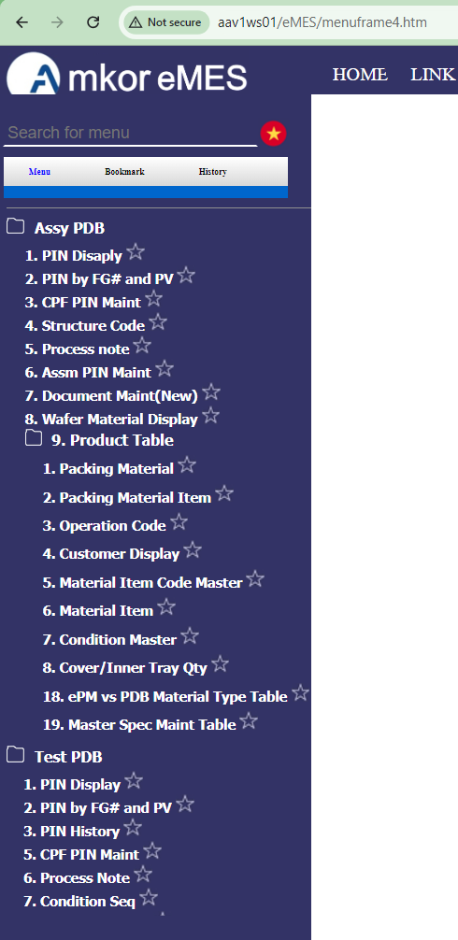

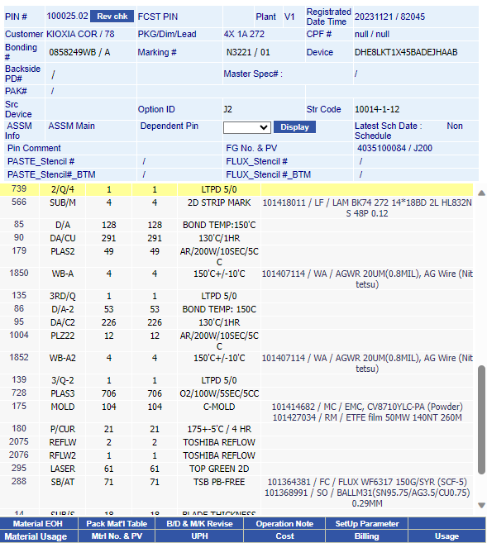
5, eMES overview
PDB (Product Database)
User – PC/CS, Central IE(SAP)
Main function
Inquiry Pin information
Create with FG information from SAP
* Pin#= Product identifier Number
Menu : eMES > Assy PDB, eMES > Test PDB
FG / Routing / BOM Creation
Interface
Automatic Pin Creation
Notes:
Show link eMES, expand the menu to show the detail to more explain

Slide 18
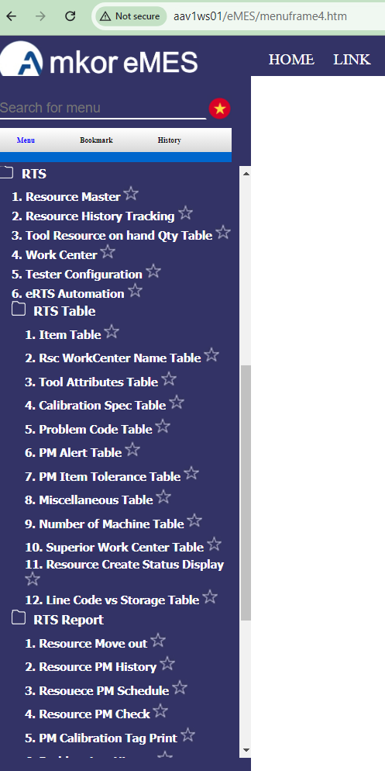
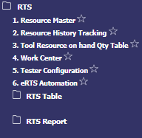
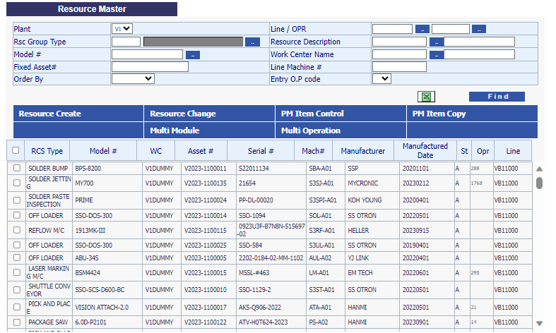
5, eMES overview
RTS
User – Central IE(RTS), Equipment manage team
Provide equipment information for eCIM &
WIP Console
Main functions
Equipment registration at SAP => Automatic registration in RTS
Problem & line transfer history management
Equipment PM history management
Designate Line & Operation per equipment
Menu : eMES > RTS
Notes:
Show link eMES, expand the menu to show the detail to more explain

Slide 19
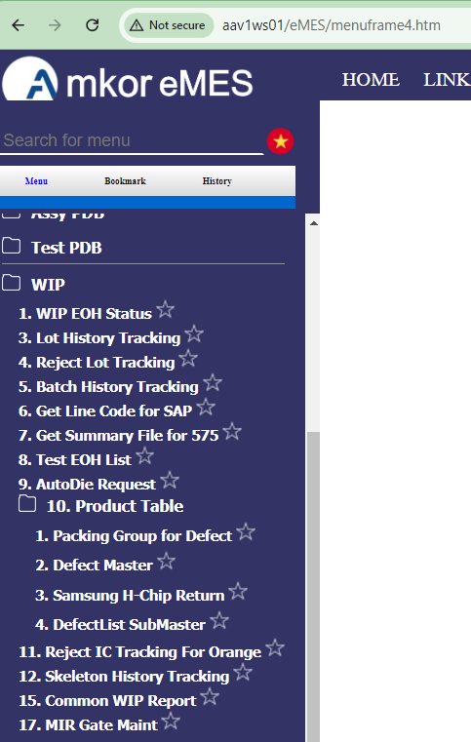
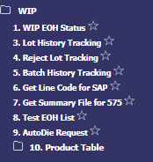
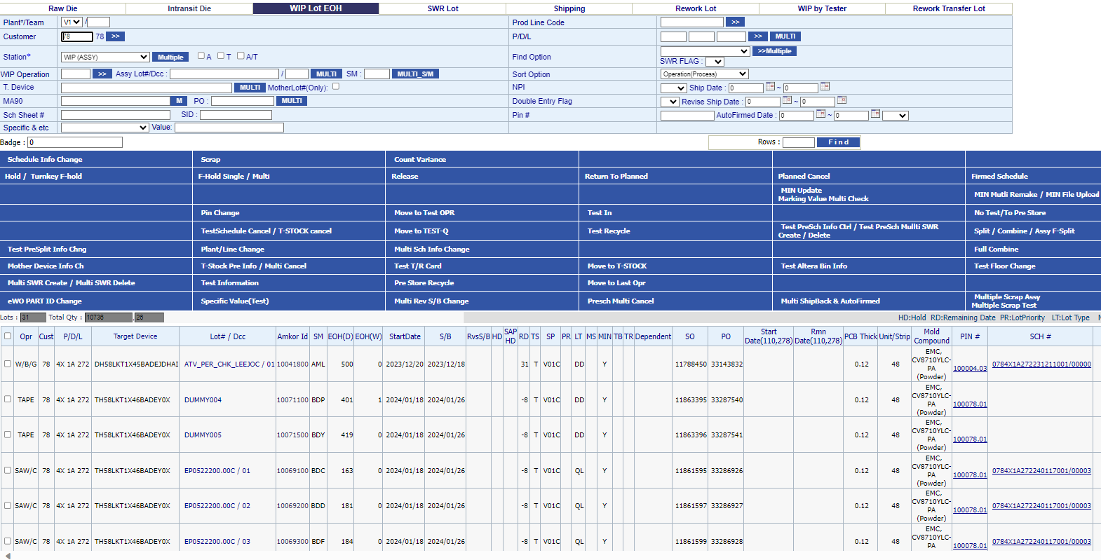
5, eMES overview
USER – PCS/ENGR
Main functions
WIP EOH Status
Lot History Tracking
Lot information management
Menu : eMES > WIP
WIP EOH
Notes:
Active/Scrap/Hold

Slide 20
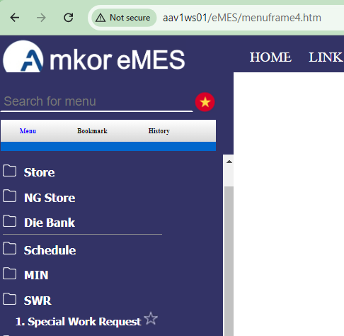
5, eMES overview
SWR
USER – PE/PCS
Main functions
SWR Creation & Approval
Lot Assignment
Menu : eMES > SWR
Originator
Create New SWR
SWR Complete?
N
Cancel SWR?
N
Save As Draft
Submit SWR
END
Disapprove
Approver 01
Approver
Originator
Approver 02
All Approved?
Reject SWR
Re-Submit SWR
Approver n
SWR Rejected
Approver 10
SWR Approved
N
Notes:
Show link eMES, expand the menu to show the detail to more explain

Slide 21
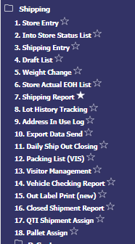
5, eMES overview
Shipment 1/2
USER – Logistics
Main functions
Store Entry
Shipping Entry
Weight Change
Data Send/Daily Closing
Table/Report
*1)Lot Acceptance
Sequence Number
*3)Input weight value
*4)Data Sending
*6)Forwarder Table
Lot Return to Line
*2)Auto Carton Assign
Shipping Cancellation
Shipping Confirm
*7)Packing List Instruction
Invoice # Assign
Early Ship Alert
*8)Paking List Report
Holding of lot
*5)Daily Closing
Store Actual EOH list
Return to Line
Shipping Status List
^{*1)} Lot Acceptance : Selecting lots with physical endorsement from WIP/Production
^{*2)} Auto Carton Assign : Auto outer box assignment to determine the total number of outer box for PLI creation
^{*3)} Input weight value : Actual weight of each outer box to reflect in PLR
^{*4)} Data Sending : Sending of closed shipments per Sequence # and interface into IFSHIP Table
^{*5)} Daily Closing : One time sending of Auto shipalert distributed to all customers not enrolled in early shipalert
*6) Forwarder Table : Updating of table to reflect assigned forwarder and shipment scheduled days
^{*7)} Packing List Instruction : Report generated for packer reference during pick and pack of actual shipment
*8) Packing List Report : Document printed out and send to customer together with the actual shipment
Notes:
Show link eMES, expand the menu to show the detail to more explain

Slide 22
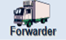


5, eMES overview
Shipment 2/2
eMES Transaction
Store Entry
SAP Transaction
Shipping Activities
Split/ Combine
Booking
Invoice/ Carton
Assign
Invoicing
Wafer Return
To Customer
Packing
Customs Clearance
Interfaced
Die Bank
Weight Change
Transfer
eMES
SAP
Wafer Return
Label Attach
Schedule
In-Line
QA Inspection
for Micron
Air
Back-End
Data Send to EXIM
Inner Box Packing
Daily Closing
(Auto Ship Alert)
PC/CS
WIP
Dropship Process2
Shipping
Notes:
Show link eMES, expand the menu to show the detail to more explain

Slide 23
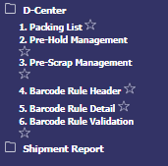
5, eMES overview
Drop Ship 1/2
USER – Logistics
Main functions
Receiving Mgmt.
Order Mgmt.
Shipping Mgmt.
Dropship Mobile
Table / Report
Cust. Lot Receiving
^{*3)}Order Entry
^{*4)}Carton & Invoice
Assign
Bar-code Location
Packing Validation
Rule
^{*1)} Store Lot Accept
Order Update/ Delete
Weight Change
Bar-Code Shipping
Actual Split Log
Maintenance
^{*2)} Lot Info. Change
Lot Picking
Shipping Cancel
Bar-code Label
Checking
D-center Reports
Rack Assignment
Split & Combine
Return to Pre Store
Bar-code Inventory
^{*5)}Stock Card
Hold / Release
Multi Lots Binding
Shipping Label Print
Bar-code Scrap
^{*6)}Daily Order Status
^{*1)}Store Lot Accept : Endorse actual lots to dropship from production and accept it in eDIS.
^{*2)}Lot Info. Change : In case of updating lot Information such as Device, Customer Lot# and Invoice#…etc.
^{*3)}Order Entry : All information of order sheet will be registered in e-DIS and can be used when needed.
^{*4)}Carton & Invoice Assign : Carton and Invoice assign in eDIS to make a shipments.
^{*5)}Stock Card : Easy Checking and balance/inventory history management
^{*6)}Daily Order Status : Labor management from daily order status
Notes:
Show link eMES, expand the menu to show the detail to more explain

Slide 24
5, eMES overview
Drop Ship 2/2
eMES Transaction
Store Entry
SAP Transaction
Shipping Activities
Split/ Combine
Booking
Invoice/ Carton
Assign
Invoicing
Wafer Return
To Customer
Packing
Customs Clearance
Interfaced
Die Bank
Weight Change
Transfer
eMES
SAP
Wafer Return
Label Attach
Schedule
In-Line
QA Inspection
for Micron
Air
Back-End
Data Send to EXIM
Inner Box Packing
Daily Closing
(Auto Ship Alert)
PC/CS
WIP
Dropship Process2
Shipping
Notes:
Show link eMES, expand the menu to show the detail to more explain

Slide 25

SAP Module
Amkor Adopted Module
- SD, PP, MM, FI, CO
SD(Sales & Distribution) - PCS, EXIM
Schedule / Billing /
Forecast input & analyze DO error
FI - Finance team
Financial Accounting/Fixed cost/
Tax affairs/Foreign Exchange /
Receipts & Payments
SD
MM
PP(Prod Planning) - PCS, IE, MDM
SO&PO creation & scheduling
Management Production System/Fcst commit
FG master creation & management
CO - Controlling
Cost management/Profitability Analysis
Activity Based Management (ABM)
PP
SAP ERP
CO
FI
MM - Purchasing, Mat’l Management
GI to PO / Inventory & Purchasing
Material Resource Planning (MRP)
QM,PM,TR
PM - Asset Accounting (AA)
QM ( QA)
- Material Inspection managing
TR( Finance Team)
- Funds Management, Budget
Amkor Partially Adopted Module
- PM, QM, TR

Slide 26
SAP Module by Team
Module
TEAM
PP
MM
SD
CO
FI
MFG
PO confirmation
GI/GR/DTS/USAGE
GI TO PO
Inventory
Production Planning
PCS team
SO/PO Creation
Interface to eMES
Mat’l Reserve
BOR
Input the FCST
Production Planning
Management of DO error
Sales
Input the FCST
Sales Planning
Purchasing
MRP
Logistics
Mat’l GR/GI/Transfer
Inventory
Logistics
DO, Booking
TC Price Billing
IE
Closing
Closing
Closing
Financing
GR IV
Inventory
Cost Analysis
CO Closing
ABM
Financial Accounting
FI Closing
PCS&IE
DTS
Usage
FCST Commit
IE
FG(Routing&DTS)
PO Confirmation
Storage location
FG(BOM&STD usage)
GI to PO
ME Closing/Inventory
FG(Strategic Material)
IT
Interface & Program

Slide 27







6, IT Activities and Improvements
What is RPA ?
➔ Robotic Process Automation ➔ automatically manual task for human in computer
How to do ?
by available RPA software:
Notes:
Benefit to use RPA. We have plan to dev RPA for Logistic

Slide 28
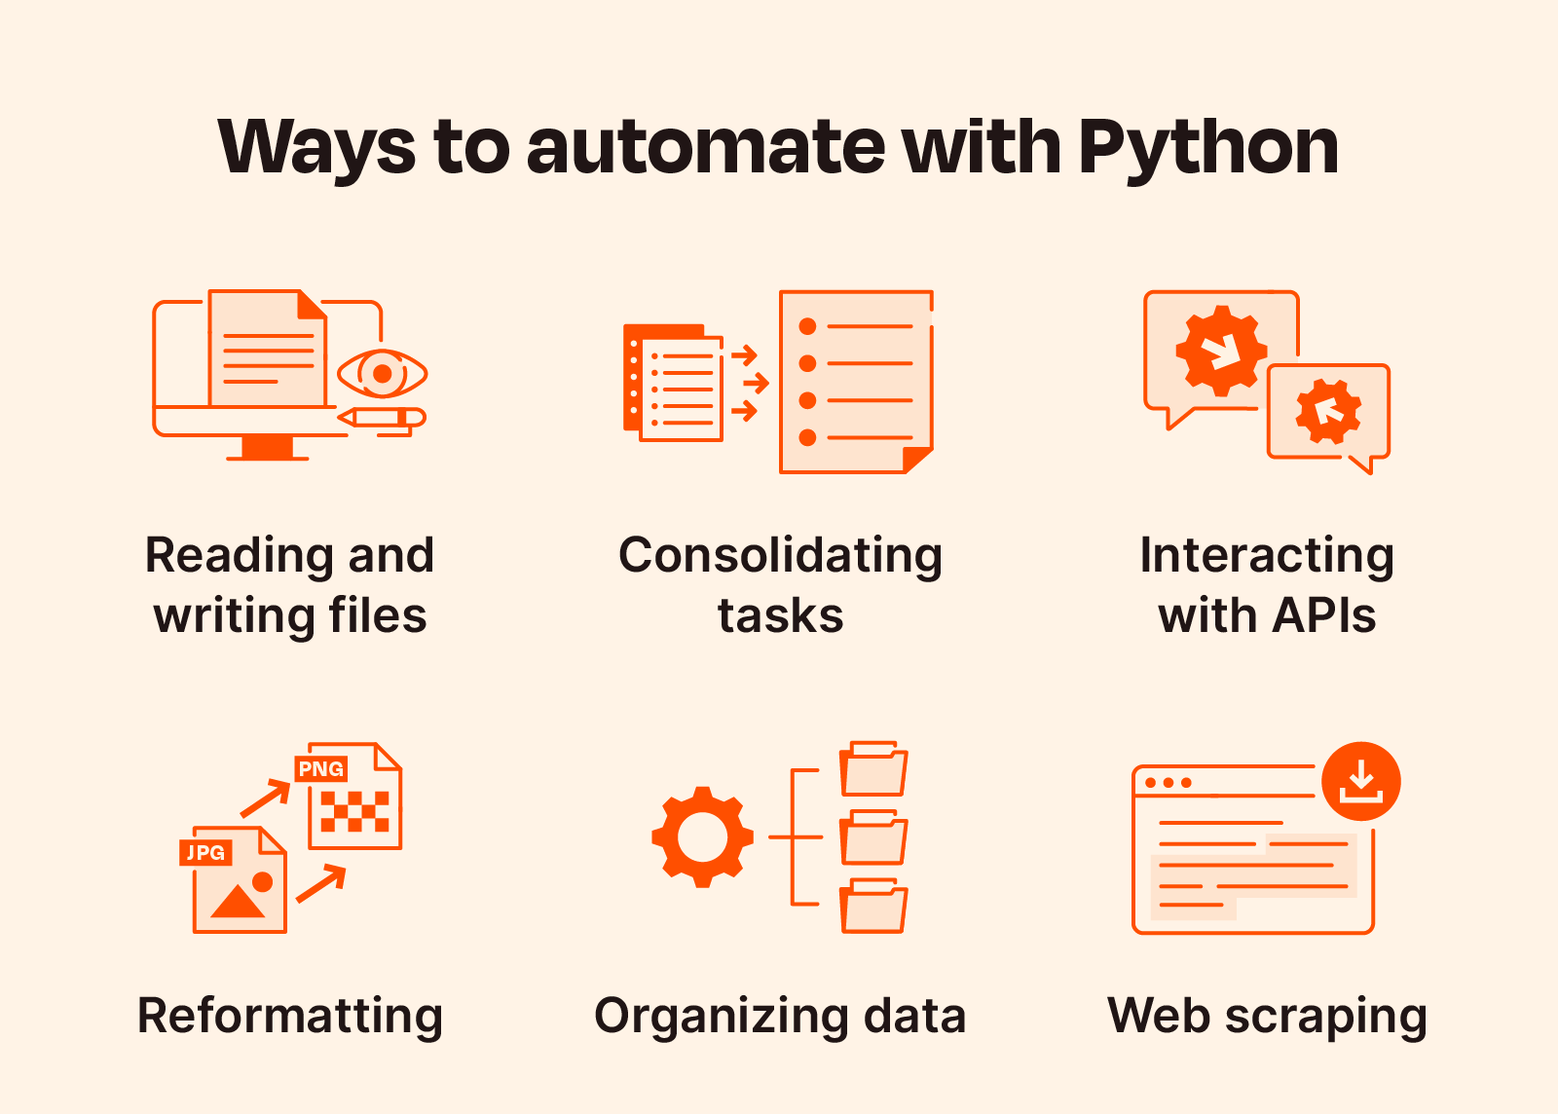
6, IT Activities and Improvements
AOA (RPA)
Project:
- 8 Project for HRD team
- 1 Project for IE team
➔ Reduce: 17.85 hours/week
Notes:
The diagram should show the relationship between IT, databases, and software. You can show how data flows from input devices such as a keyboard to the database and then to software applications.

Slide 29
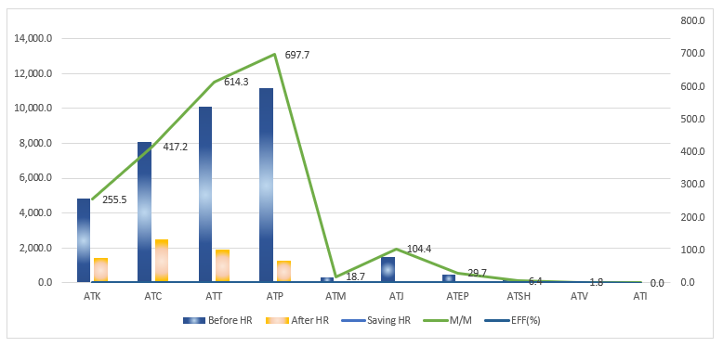
Achievements : Time & Resource Saving (As of AUG)
6, IT Activities and Improvements
Site | # of Dev | Before HR | After HR | Saving HR | M/M | Saving HR | M/M | EFF(%)
 |  | (Monthly) | (Monthly) | (Monthly) | (Monthly) | (Yearly) | (Yearly)
ATK | 328 | 4,846.1 | 1,439.2 | 3,406.9 | 21.3 | 40,882.2 | 255.5 | 70.3%
ATC | 344 | 8,070.2 | 2,497.4 | 5,562.8 | 34.8 | 65,108.0 | 417.2 | 69.1%
ATT | 313 | 10,086.6 | 1,895.3 | 8,191.2 | 51.2 | 98,294.9 | 614.3 | 81.2%
ATP | 193 | 11,183.0 | 1,265.4 | 9,302.1 | 58.1 | 111,624.8 | 697.7 | 88.7%
ATM | 34 | 317.9 | 68.1 | 249.8 | 1.6 | 2,997.6 | 18.7 | 78.6%
ATJ | 59 | 1,479.9 | 87.1 | 1,391.8 | 8.7 | 16,701.0 | 104.4 | 94.1%
ATEP | 22 | 489.0 | 93.0 | 396.0 | 2.5 | 4,752.0 | 29.7 | 81.0%
ATSH | 13 | 154.6 | 68.7 | 85.9 | 0.5 | 1,030.6 | 6.4 | 55.6%
ATV | 10 | 24.1 | 0.3 | 23.8 | 0.1 | 285.4 | 1.8 | 98.8%
ATI | 0 | 0.0 | 0.0 | 0.0 | 0.0 | 0.0 | 0.0 | 0
TTL | 1,316.0 | 36,651.2 | 7,414.5 | 28,610.2 | 178.8 | 341,676.4 | 2,145.7 | 79.77%
* 1 M/M= 160 hours
79.8% Work
Efficiency
Notes:
We find the manual process painful from user and try to reduce it
It will make users can have more time to make more values
It’s almos 80% (meaning user do manual 100% then reduce 80 but must manual by 20%)

Slide 30





Python Training Course Teacher: Quan Nguyen Duc Asist: Richard, Cody Hiep participants: 15 mem’s participants : 18 days training
6, IT Activities and Improvements
Training Contents:
- Python basic - Python with Automation task by pyautogui
- Python with Excel operations & Send email
TOTAL OF
15
Participants
7 Output projects
Python Installation
Training under
Quan Nguyen Duc
(Phase 1)
Trainees
Final Projects
Deploy
23.14 Hrs/wk reduced
Batch 1 (18 days/1h/day) (Pcs, IE, Pur, Log, Test, Eng …)​ | 20 April ‘24​ | 22 April ‘24​ | 3 Jun‘24​ | 15 Jul ’24
Notes:
In Amkor we do not only have IT as dev but also others member functional member in departments can be dev (citizen developer) => they fully understand manual process and can develop by them selve
=> That why IT + HR to hold the training python session!

Slide 31
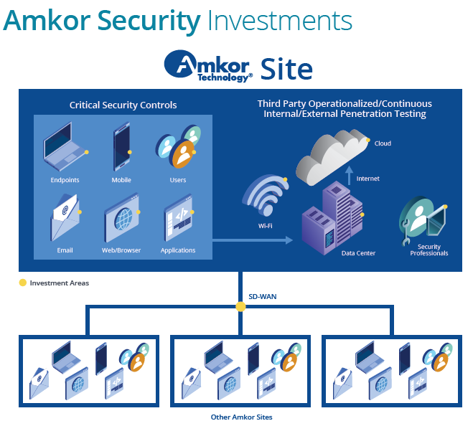

7. Info Security : Cybersecurity Measures
Protecting Amkor & Customer’s intellectual property is as important to us.
Amkor has invested in focused cybersecurity team with a mission to continually monitor and improve our overall security and that of our customer data and interfacing system.
Notes:
For purpose protect Amkor & Customer property
Amkor invest hardward + software

Slide 32
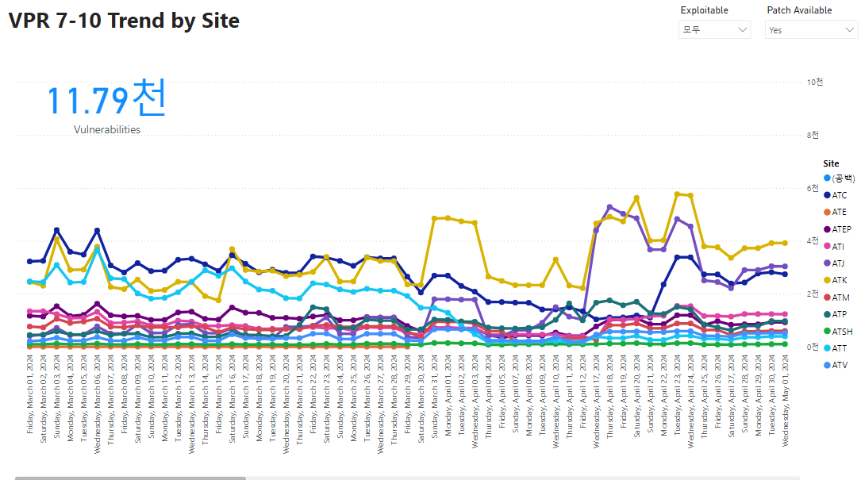
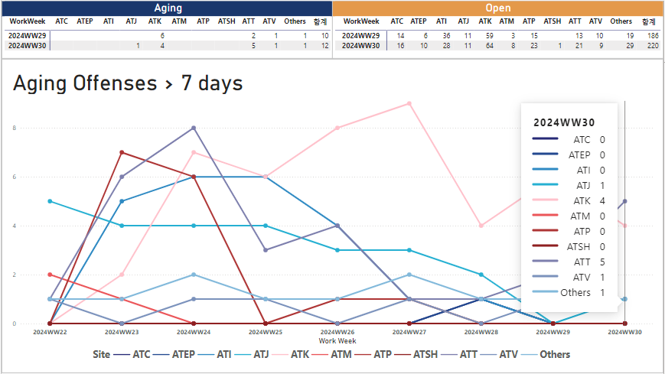
7. Info Security : Security Vulnerability /Security Offense
We periodically conduct activities to improve the security vulnerabilities of IT-related hardware & software.
All security vulnerabilities to Infra's OS, software, such as server/client/network, are analyzed and patches are ongoing at all times.
Security offenses handled by Global SOC Team and Local IT Infosec Team.
Offenses are detected and reported in real time and action is taken.
Notes:
Vulnerabilities prior rating

Slide 33
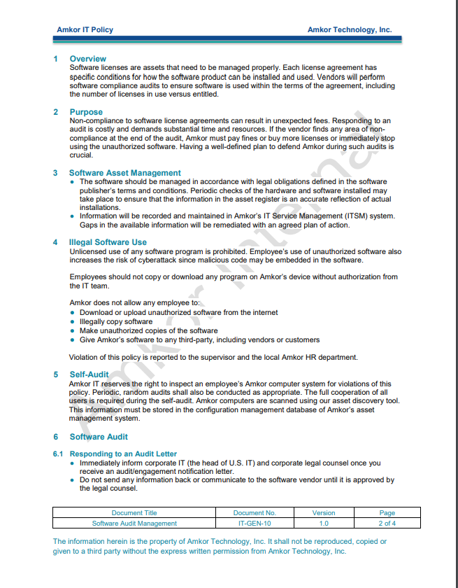
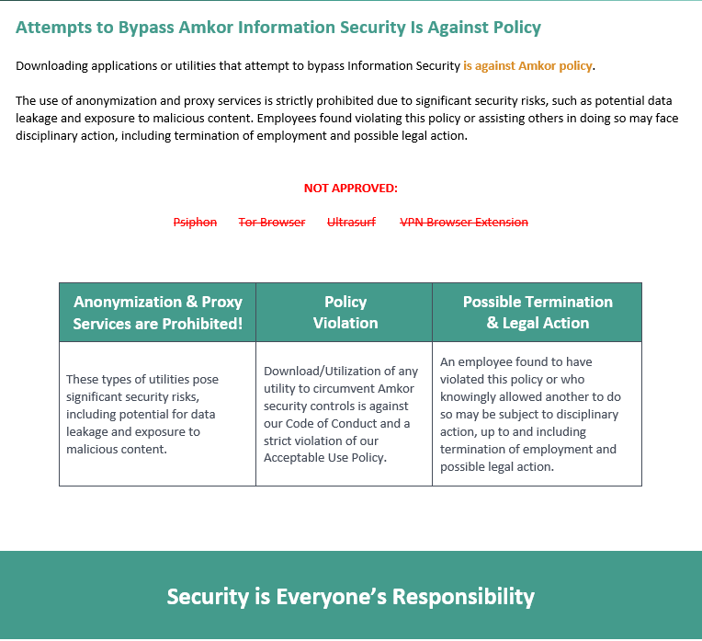

7. Info Security : Software Management
Unlicensed use of any software program is prohibited. Employee’s use of unauthorized software also increases the risk of cyberattack since malicious code may be embedded in the software.
Employees should not copy or download any program on Amkor’s device without authorization from the IT Team.
Notes:
Security is Everyone Responbility!

